Slide 1

Convolutional
Neural Networks

Slide 2
Deep Learning
Quick Review of Previous Topics and NNs
New Theory Topics
Discuss Famous MNIST Data Set
Solve MNIST with a “normal” NN
Learn about CNN
Solve MNIST with CNN
CNN Exercise and Solutions Afterwards

Slide 3
Deep Learning
Let’s get started!

Slide 4
Quick Review

Slide 5
Deep Learning
Let’s quickly review what
we’ve covered so far!

Slide 6
Deep Learning
Single Neuron
We now understand how to perform a calculation in a neuron
w · x + b = z
a = σ(z)

Slide 7
Deep Learning
Activation Functions
Perceptrons
Sigmoid
Tanh
ReLU
(We’ll discuss other functions later on)

Slide 8
Deep Learning
Connecting Neurons to create a network

Slide 9
Deep Learning
Neural Network
Input Layer
Hidden Layers
Output Layer
More layers → More Abstraction

Slide 10
Deep Learning
To “learn” we need some measurement of error.
We use a Cost/Loss Function
Quadratic
Cross-Entropy

Slide 11
Deep Learning
Once we have the measurement of error, we need to minimize it by choosing the correct weight and bias values.
We use gradient descent to find the optimal values.

Slide 12
Deep Learning
We can then backpropagate the gradient descent through multiple layers, from the output layer back to the input layer.
We also know of dense layers, and later on we’ll introduce softmax layer.

Slide 13
Deep Learning
We can then backpropagate the gradient descent through multiple layers, from the output layer back to the input layer.
We also know of dense layers, and later on we’ll introduce softmax layer.

Slide 14
Deep Learning
Very quick overview of what we know so far!
We still need to learn a bit more theory before diving into Convolutional Neural Networks!

Slide 15
New Theory Topics

Slide 16
Deep Learning
We’ve reviewed the basics, but there are still some theory components we haven’t covered yet…

Slide 17
Deep Learning
Initialization of Weights Options
Zeros
No Randomness
Not a great choice
Random Distribution Near Zero
Not Optimal
Activation Functions Distortion

Slide 18
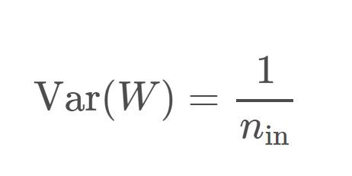
Deep Learning
Initialization of Weights Options
Xavier (Glorot) Initialization
Uniform / Normal
Draw weights from a distribution with zero mean and a specific variance

Slide 19
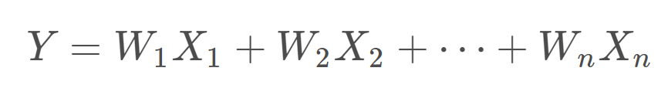
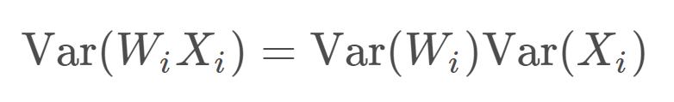
Deep Learning
Xavier Initialization

Slide 20
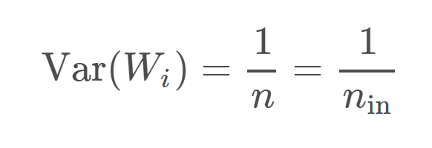
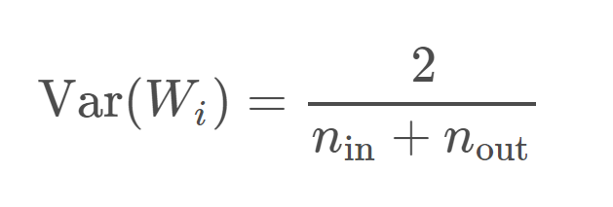
Deep Learning
Xavier Initialization

Slide 21
Deep Learning - Gradient Descent
Learning Rate - defines the step size during gradient descent
Batch Size - batches allow us to use stochastic gradient descent.
Smaller → less representative of data
Larger → longer training time

Slide 22
Deep Learning - Gradient Descent
Second-Order Behavior of the gradient descent allows us to adjust our learning rate based off the rate of descent
AdaGrad
RMSProp
Adam

Slide 23
Deep Learning - Gradient Descent
This allows us to start with larger steps and then eventually go to smaller step sizes.
Adam allows this change to happen automatically.

Slide 24
Deep Learning
Unstable / Vanishing Gradients
As you increase the number of layers in a network, the layers towards the input will be affected less by the error calculation occurring at the output as you go backwards through the network

Slide 25
Deep Learning
Unstable / Vanishing Gradients
Initialization and Normalization will help us mitigate these issues.
We’ll discuss vanishing gradients again in more detail when discussing Recurrent Neural Networks.

Slide 26
Deep Learning
Overfitting vs Underfitting a Model
y
Training Data
x

Slide 27
Deep Learning
Model Underfitting
Fitted Model on Training Data
y
x

Slide 28
Deep Learning
Model Underfitting
Get error on test data.
y
x

Slide 29
Deep Learning
Model Underfitting
Get error on test data.
High error on training and test data
y
x

Slide 30
Deep Learning
Overfitting a Model
y
Training Data
x

Slide 31
Deep Learning
Overfitting a Model
Very low error on training data!
y
x

Slide 32
Deep Learning
Overfitting a Model
But large error on test data.
y
x

Slide 33
Deep Learning
Overfitting a Model
But large error on test data.
y
x

Slide 34
Deep Learning
Need to strike a balance
y
x

Slide 35
Deep Learning
With potentially hundreds of parameters in a deep learning neural network, the possibility of overfitting is very high!
There are a few ways to help mitigate this issue.

Slide 36
Deep Learning
L1/L2 Regularization
Adds a penalty for larger weights in the model
Not unique to neural networks

Slide 37
Deep Learning
Dropout
Unique to neural networks
Remove neurons during training randomly
Network doesn’t over rely on any particular neuron

Slide 38
Deep Learning
Expanding Data
Artificially expand data by adding noise, tilting images, adding low white noise to sound data, etc...

Slide 39
Deep Learning
We still have more theory to learn, such as pooling layers, convolutional layers, etc…
But we’ll wait until we begin to build CNNs to cover those!
Let’s explore the famous MNIST data set, a must know for CNN!

Slide 40
MNIST Data

Slide 41
Deep Learning
A classic data set in Deep Learning is the MNIST data set.
Let’s quickly cover some basics about it since we’ll be using it quite frequently during this section of the course!

Slide 42
Deep Learning
Fortunately this data is easy to access with TensorFlow. TF has:
55,000 training images
10,000 test images
5,000 validation images

Slide 43
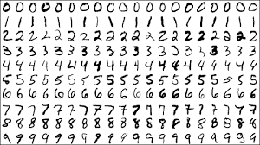
Deep Learning
The MNIST data set contains handwritten single digits from 0 to 9

Slide 44
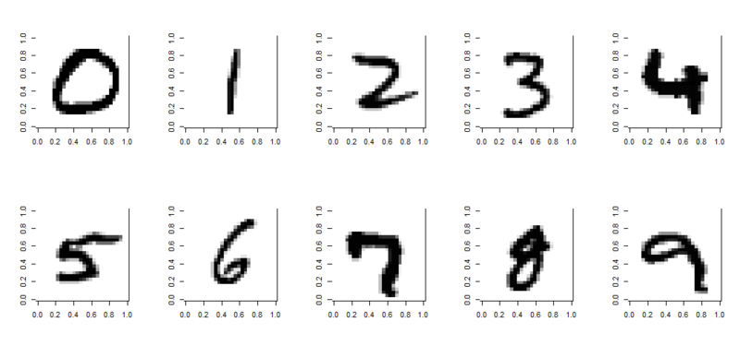
Deep Learning
A single digit image can be represented as an array

Slide 45
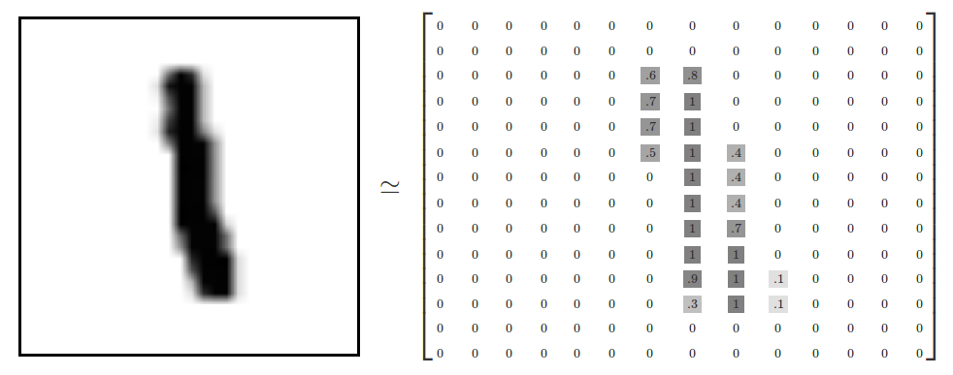
Deep Learning
Specifically, 28 by 28 pixels

Slide 46
Deep Learning
The values represent the grayscale image

Slide 47

Deep Learning
We can flatten this array to a 1-D vector of 784 numbers. Either (781,1) or (1,781) is fine, as long as the dimensions are consistent.

Slide 48
Deep Learning
Flattening out the image ends up removing some of the 2-D information, such as the relationship of a pixel to its neighboring pixels.
For now, we’ll ignore this, but come back to it later when we discuss CNN in depth!

Slide 49
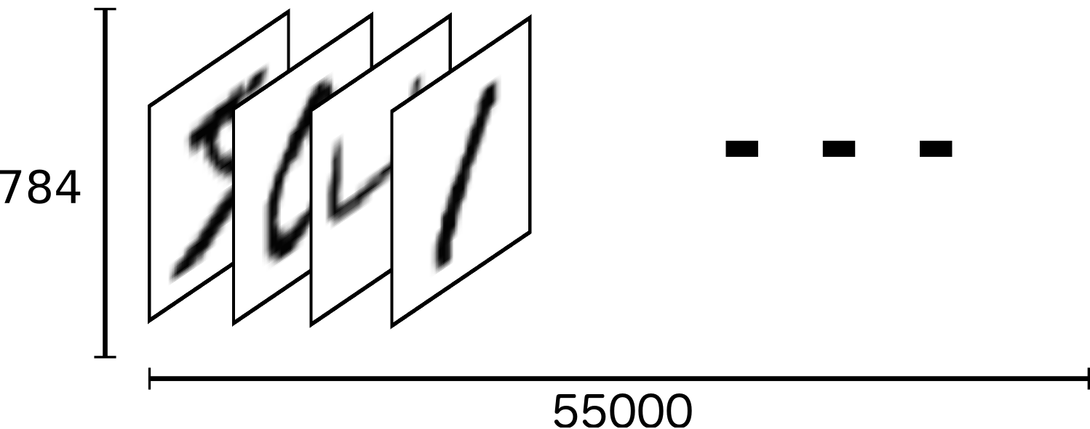
Deep Learning
We can think of the entire group of the 55,000 images as a tensor (an n-dimensional array)

Slide 50
Deep Learning
For the labels we’ll use One-Hot Encoding.
This means that instead of having labels such as “One”, “Two”, etc… we’ll have a single array for each image.

Slide 51
Deep Learning
The label is represented based off the index position in the label array.
The corresponding label will be a 1 at the index location and zero every where else.
For example, 4 would have this label array:
[0,0,0,0,1,0,0,0,0,0]

Slide 52
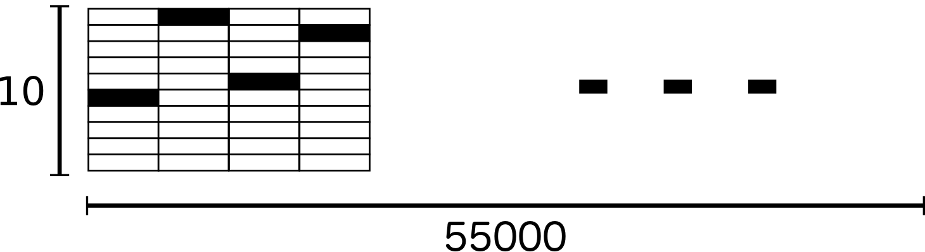
Deep Learning
As a result, the labels for the training data ends up being a large 2-d array (10,55000):

Slide 53
MNIST Data
“Basic” Approach

Slide 54
Deep Learning
Before we dive into using CNN on the MNIST data set we’ll use a more basic Softmax Regression Approach.
Let’s quickly go over this method (it’s very similar to the methods used in the previous sections)

Slide 55
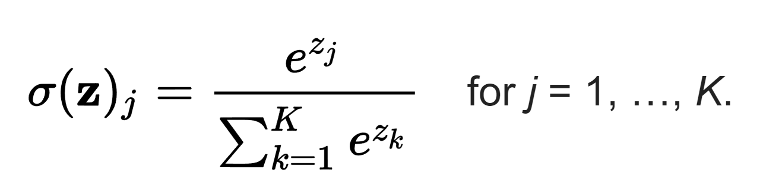
Deep Learning
A Softmax Regression returns a list of values between 0 and 1 that add up to one.
We can use this as a list of probabilities!

Slide 56
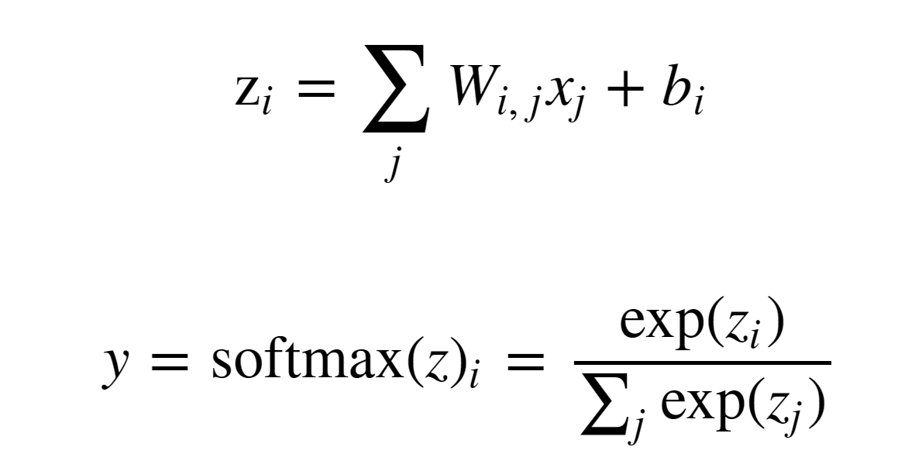
Deep Learning
We’ll use Softmax as our activation function.

Slide 57
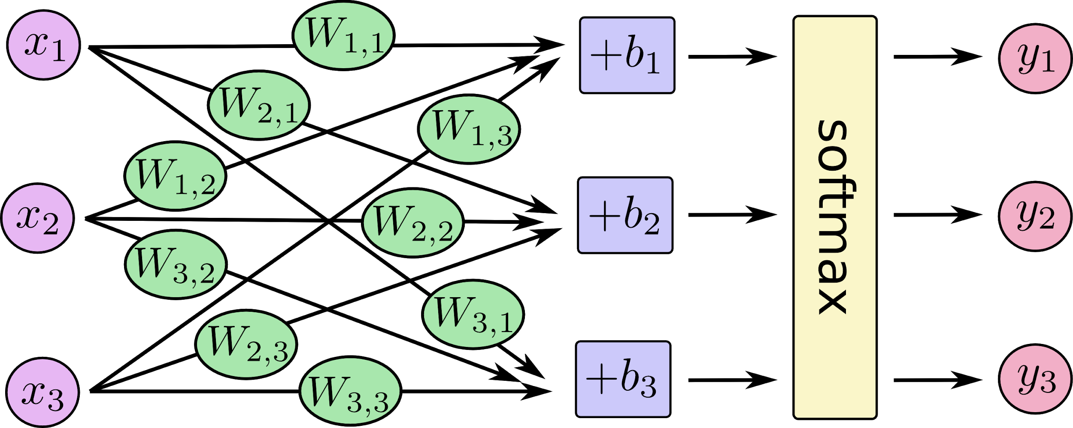
Deep Learning
Our Network

Slide 58
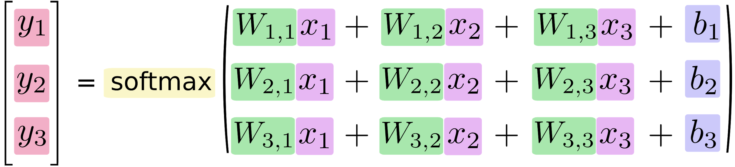
Deep Learning
As an equation

Slide 59
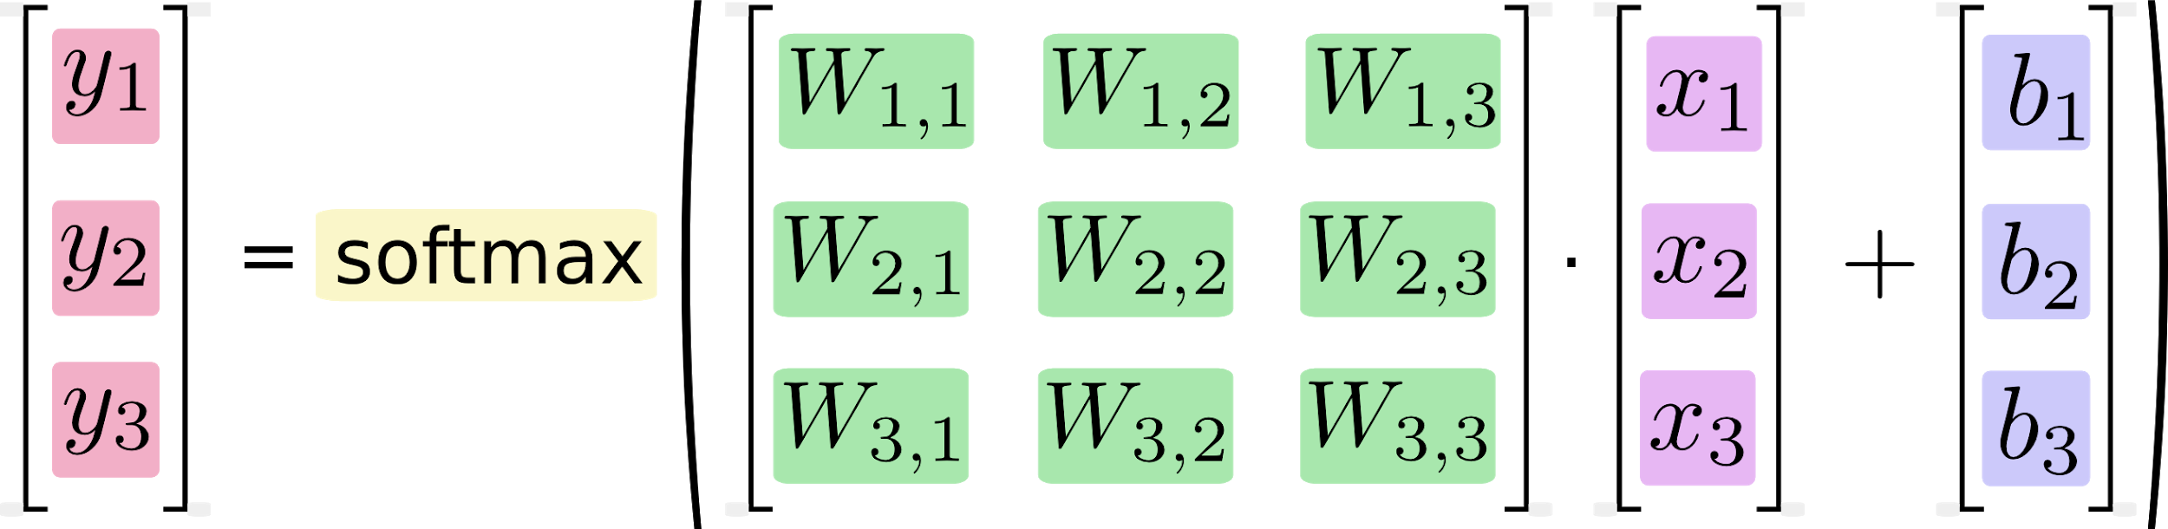
Deep Learning
As an equation

Slide 60
Deep Learning
Let’s implement this with Python and TensorFlow!

Slide 61
Convolutional
Neural Networks

Slide 62
Deep Learning
We just solved the MNIST task with a very simple linear approach.
Let’s explore a much better approach using Convolutional Neural Network.

Slide 63
Deep Learning
Just like the simple perceptron, CNNs also have their origins in biological research.
Hubel and Wiesel studied the structure of the visual cortex in mammals, winning a Nobel Prize in 1981.

Slide 64
Deep Learning
Their research revealed that neurons in the visual cortex had a small local receptive field.

Slide 65
Deep Learning
This idea then inspired an ANN architecture that would become CNN
Famously implemented in the 1998 paper by Yann LeCun et al.
The LeNet-5 architecture was first used to classify the MNIST data set.

Slide 66
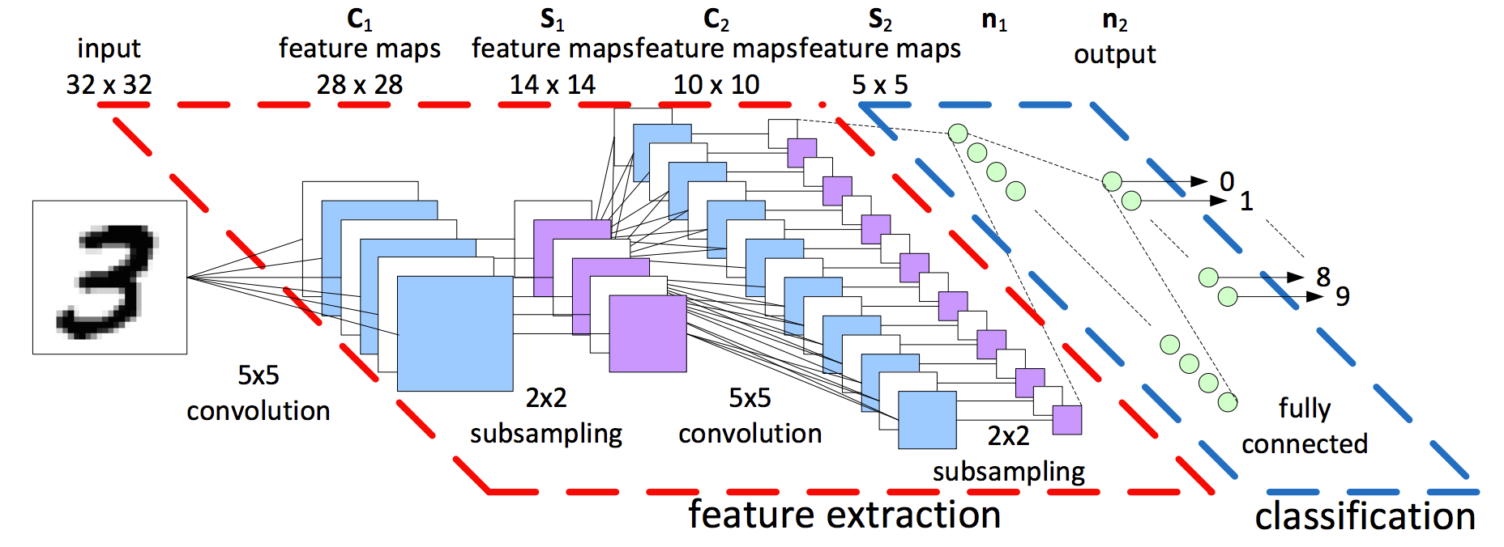
Deep Learning
When learning about CNNs you’ll often see a diagram like this:

Slide 67
Deep Learning
Let’s break down the various aspects of a CNN seen here:

Slide 68
Deep Learning
Tensors
DNN vs CNN
Convolutions and Filters
Padding
Pooling Layers
Review Dropout

Slide 69
Deep Learning
Recall that Tensors are N-Dimensional Arrays that we build up to:
Scalar - 3
Vector - [3,4,5]
Matrix - [ [3,4] , [5,6] , [7,8] ]
Tensor - [[ [ 1, 2] , [ 3, 4] ],
[[ 5, 6] , [ 7, 8]]]

Slide 70
Deep Learning
Tensors make it very convenient to feed in sets of images into our model - (I,H,W,C)
I : Images
H: Height of Image in Pixels
W: Width of Image in Pixels
C: Color Channels: 1-Grayscale, 3-RGB

Slide 71
Deep Learning
Now let’s explore the difference between a Densely Connected Neural Network and a Convolutional Neural Network.
Recall that we’ve already been able to create DNNs with tf.estimator API.

Slide 72
Deep Learning
Densely Connected layer

Slide 73
Deep Learning
Convolutional Layer

Slide 74
Deep Learning
Each unit is connected to a smaller number of nearby units in next layer.

Slide 75
Deep Learning
So why bother with a CNN instead of a DNN?

Slide 76
Deep Learning
The MNIST dataset was 28 by 28 pixels (784 total)
But most images are at least 256 by 256 or greater, (<56k total)!
This leads to too many parameters, unscalable to new images.

Slide 77
Deep Learning
Convolutions also have a major advantage for image processing, where pixels nearby to each other are much more correlated to each other for image detection.

Slide 78
Deep Learning
Each CNN layer looks at an increasingly larger part of the image.
Having units only connected to nearby units also aids in invariance.
CNN also helps with regularization, limiting the search of weights to the size of the convolution.

Slide 79
Deep Learning
Let’s explore how the convolutional neural network relates to image recognition!
We start with the input layer, the image itself.

Slide 80
Deep Learning
Convolutional layers are only connected to pixels in their respective fields.
Convolutional Layer 1
Input Layer

Slide 81
Deep Learning
Convolutional layers are only connected to pixels in their respective fields.
Convolutional Layer 2
Convolutional Layer 1
Input Layer

Slide 82
Deep Learning
We run into a possible issue for edge neurons! There may not be an input there for them.

Slide 83
Deep Learning
We can fix this by adding a “padding” of zeros around the image.

Slide 84
Deep Learning
Let’s walk through 1-D Convolution in more detail, then expand this idea to 2-D Convolution.
Let’s revisit our DNN and convert it to a CNN.

Slide 85
Deep Learning
A DNN

Slide 86
Deep Learning
1-D Convolution
w1
w2

Slide 87
Deep Learning
1-D Convolution
We can treat these weights as a filter.
w1
w2

Slide 88
Deep Learning
1-D Convolution
y = w₁x₁ + w₂x₂
If (w_{1,}w₂) = (1,-1) Then y = x₁ - x₂
When is y at a maximum?
(x_{1,}x₂) = (1,0)
w1
w2

Slide 89
Deep Learning
1-D Convolution
y = w₁x₁ + w₂x₂
If (w_{1,}w₂) = (1,-1) Then y = x₁ - x₂
When is y at a maximum?
(x_{1,}x₂) = (1,0)
w1
w2
w1
w2
w1
w2

Slide 90
Deep Learning
1-D Convolution
We now have a set of weights that can act as a filter for edge detection!
We can then expand this idea to multiple filters.
w1
w2
w1
w2
w1
w2

Slide 91
Deep Learning
1-D Convolution
Filters: 1
Filter Size: 2
Stride: 2
w1
w2
w1
w2
w1
w2

Slide 92
Deep Learning
1-D Convolution
Filters: 1
Filter Size: 2
Stride: 1 (1 Unit at a time)
w1
w2

Slide 93
Deep Learning
1-D Convolution
Remember that we can add zero padding to include more edge pixels.
w1
w2

Slide 94
Deep Learning
1-D Convolution
Filters: 2
Filter Size: 2
Stride: 1 (1 Unit at a time)

Slide 95
Deep Learning
1-D Convolution
Filters: 4
Filter Size: 2
Stride: 1 (1 Unit at a time)
w1
w2

Slide 96
Deep Learning
1-D Convolution
Each filter is detecting a different feature
w1
w2

Slide 97
Deep Learning
1-D Convolution
Filters: 4
Filter Size: 2
Stride: 1 (1 Unit at a time)

Slide 98
Deep Learning
1-D Convolution
For simplicity, we begin to describe and visualize these sets of neurons as blocks instead

Slide 99
Deep Learning
1-D Convolution
For simplicity, we begin to describe and visualize these sets of neurons as blocks instead
1 x L

Slide 100
Deep Learning
1-D Convolution
For simplicity, we begin to describe and visualize these sets of neurons as blocks instead
# of filters
# of units
1 x L

Slide 101
Deep Learning
Let’s now expand these concepts to 2-D Convolution, since we’ll mainly be dealing with images.

Slide 102
Deep Learning - 2D Convolution
Input Image: (H,W)
# of filters
# of units W
# of units H

Slide 103
Deep Learning - 2D Convolution
Input Image: (H,W)
# of filters
# of units W
# of units H
h
w

Slide 104
Deep Learning - 2D Color Images
Input Image: (H,W,C)
# of filters
# of filters
# of units W
# of units H

Slide 105
Deep Learning- 2D Color Images
Input Image: (H,W,C)
# of filters
# of filters
# of units W
# of units H
h
w
c

Slide 106
Deep Learning
Filters are commonly visualized with grids
0 | 0 | 0 | 0 | 0 | 0
0 | 1 | 1 | 1 | 1 | 0
0 | 1 | -1 | -1 | 1 | 0
0 | 1 | -1 | -1 | 1 | 0
0 | 1 | 1 | 1 | 1 | 0
0 | 0 | 0 | 0 | 0 | 0

Slide 107
Deep Learning
Filters are commonly visualized with grids
0 | 0 | 0 | 0 | 0 | 0
0 | 1 | 1 | 1 | 1 | 0
0 | 1 | -1 | -1 | 1 | 0
0 | 1 | -1 | -1 | 1 | 0
0 | 1 | 1 | 1 | 1 | 0
0 | 0 | 0 | 0 | 0 | 0
0 | 0 | 0
0 | -1 | 1
0 | 1 | -1
3 by 3 Filter

Slide 108
Deep Learning
Filters are commonly visualized with grids
0 | 0 | 0 | 0 | 0 | 0
0 | 1 | 1 | 1 | 1 | 0
0 | 1 | -1 | -1 | 1 | 0
0 | 1 | -1 | -1 | 1 | 0
0 | 1 | 1 | 1 | 1 | 0
0 | 0 | 0 | 0 | 0 | 0
0 | 0 | 0
0 | -1 | 1
0 | 1 | -1
3 by 3 Filter

Slide 109
Deep Learning
Filters are commonly visualized with grids
0 | 0 | 0 | 0 | 0 | 0
0 | 1 | 1 | 1 | 1 | 0
0 | 1 | -1 | -1 | 1 | 0
0 | 1 | -1 | -1 | 1 | 0
0 | 1 | 1 | 1 | 1 | 0
0 | 0 | 0 | 0 | 0 | 0
0 | 0 | 0
0 | -1 | 1
0 | 1 | -1
0×0 | 0×0 | 0×0
0×0 | 1×-1 | 1×1
0×0 | 1×1 | 1×-1
3 by 3 Filter
Multiply by filter weights

Slide 110
Deep Learning
Filters are commonly visualized with grids
0 | 0 | 0 | 0 | 0 | 0
0 | 1 | 1 | 1 | 1 | 0
0 | 1 | -1 | -1 | 1 | 0
0 | 1 | -1 | -1 | 1 | 0
0 | 1 | 1 | 1 | 1 | 0
0 | 0 | 0 | 0 | 0 | 0
0 | 0 | 0
0 | -1 | 1
0 | 1 | -1
0×0 | 0×0 | 0×0
0×0 | 1×-1 | 1×1
0×0 | 1×1 | 1×-1
0 | 0 | 0
0 | -1 | 1
0 | 1 | -1
0
3 by 3 Filter
Multiply by filter weights
Sum the Result

Slide 111
Deep Learning
Stride Distance of 1 Example
0 | 0 | 0 | 0 | 0 | 0
0 | 1 | 1 | 1 | 1 | 0
0 | 1 | -1 | -1 | 1 | 0
0 | 1 | -1 | -1 | 1 | 0
0 | 1 | 1 | 1 | 1 | 0
0 | 0 | 0 | 0 | 0 | 0
0 | 0 | 0
0 | -1 | 1
0 | 1 | -1
3 by 3 Filter

Slide 112
Deep Learning
Stride Distance of 2 Example
0 | 0 | 0 | 0 | 0 | 0
0 | 1 | 1 | 1 | 1 | 0
0 | 1 | -1 | -1 | 1 | 0
0 | 1 | -1 | -1 | 1 | 0
0 | 1 | 1 | 1 | 1 | 0
0 | 0 | 0 | 0 | 0 | 0
0 | 0 | 0
0 | -1 | 1
0 | 1 | -1
3 by 3 Filter

Slide 113
Deep Learning
Representation of Multiple Filters
0 | 0 | 0 | 0 | 0 | 0
0 | 1 | 1 | 1 | 1 | 0
0 | 1 | -1 | -1 | 1 | 0
0 | 1 | -1 | -1 | 1 | 0
0 | 1 | 1 | 1 | 1 | 0
0 | 0 | 0 | 0 | 0 | 0
3 by 3 Convolution

Slide 114
Deep Learning
At the original CNN diagram

Slide 115
Deep Learning
Exactly what we saw here:

Slide 116
Deep Learning
Now it is time to discuss subsampling (pooling)

Slide 117
Convolutional
Neural Networks
Part Two

Slide 118
Deep Learning
Now that we understand convolutional layers, let’s discuss pooling layers.
Pooling layers will subsample the input image, which reduces the memory use and computer load as well as reducing the number of parameters.

Slide 119
Deep Learning
Let’s imagine a layer of pixels in our input image:

Slide 120
Deep Learning
For our MNIST digits set, each pixel had a value representing “darkness”
0 | .2 | 0 | ...
.4 | .3 | 0 | ...
... | ... | ... | ...

Slide 121
Deep Learning
We create a 2 by 2 pool of pixels and evaluate the maximum value.
0 | .2 | 0 | ...
.4 | .3 | 0 | ...
... | ... | ... | ...

Slide 122
Deep Learning
Only the max value makes it to the next layer.
0 | .2 | 0 | ...
.4 | .3 | 0 | ...
... | ... | ... | ...
0.4

Slide 123
Deep Learning
We then move over by a “stride”, in this case, our stride is two.
0 | .2 | 0 | ...
.4 | .3 | 0 | ...
... | ... | ... | ...
0.4
Max

Slide 124
Deep Learning
This pooling layer will end up removing a lot of information, even a small pooling “kernel” of 2 by 2 with a stride of 2 will remove 75% of the input data.

Slide 125
Deep Learning
Another common technique deployed with CNN is called “Dropout”
Dropout can be thought of as a form of regularization to help prevent overfitting.
During training, units are randomly dropped, along with their connections.

Slide 126
Deep Learning
This helps prevent units from “co-adapting” too much.
Let’s also quickly point out some famous CNN architectures!

Slide 127
Deep Learning
LeNet-5 by Yann LeCun
AlexNet by Alex Krizhevsky et al.
GoogLeNet by Szegedy at Google Research
ResNet by Kaiming He et al.
Check out the resource links to the papers discussing these architectures!

Slide 128
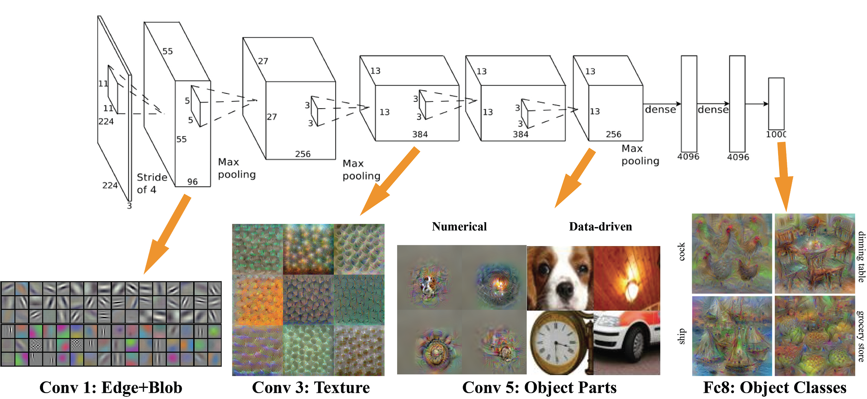
Deep Learning
AlexNet

Slide 129
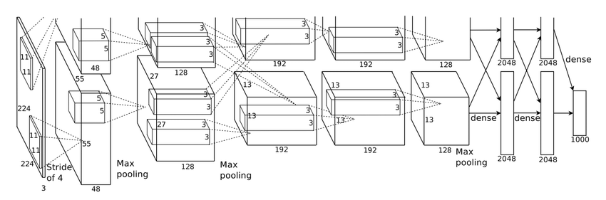
Deep Learning
AlexNet

Slide 130
Deep Learning
Convolutional Neural Network

Slide 131
Deep Learning
Check out the various supplementary resources!
Now that we’ve covered the basics of CNN, let’s explore how to implement one in TensorFlow!

Slide 132
MNIST Data
CNN Code Along

Slide 133
CNN CIFAR-10 Exercise

Slide 134
CNN CIFAR-10 Exercise
Solutions Part Two

Slide 135
Deep Learning
Optional CNN Exercise with the CIFAR-10 data set.
Main challenge is dealing with data and creating Tensor batches and sizing.
Let’s go through the exercise notebook!

Slide 136
Deep Learning
We have our color image represented as a 3-D prism. Width, Height, and Depth (3 values R, G, B)
R
G
B
Height
Width

Slide 137
Deep Learning
Run a neural network on a portion
R
G
B
Height
Width

